Slide 1
DEVRY University Media Relations Highlights

Slide 2
Public Relations Focus Areas
News and Trends
Degree Program Launches
Expansions
Student Innovations
Thought Leaders and Industry Experts

Slide 3
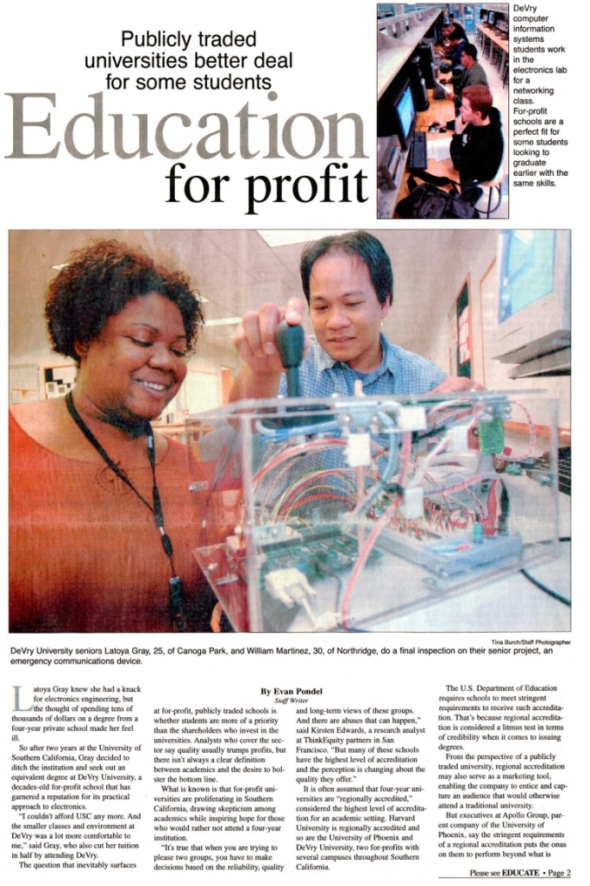
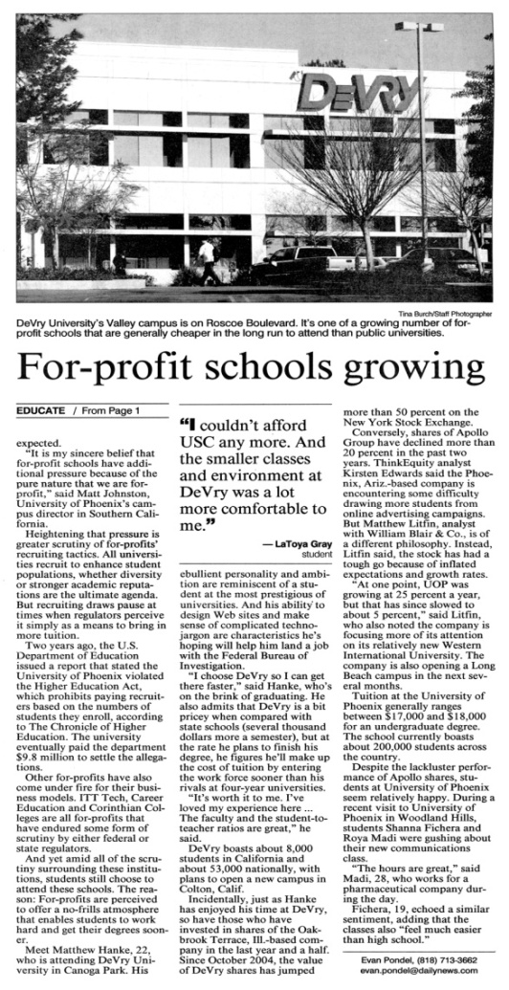
News and Trends

Slide 4
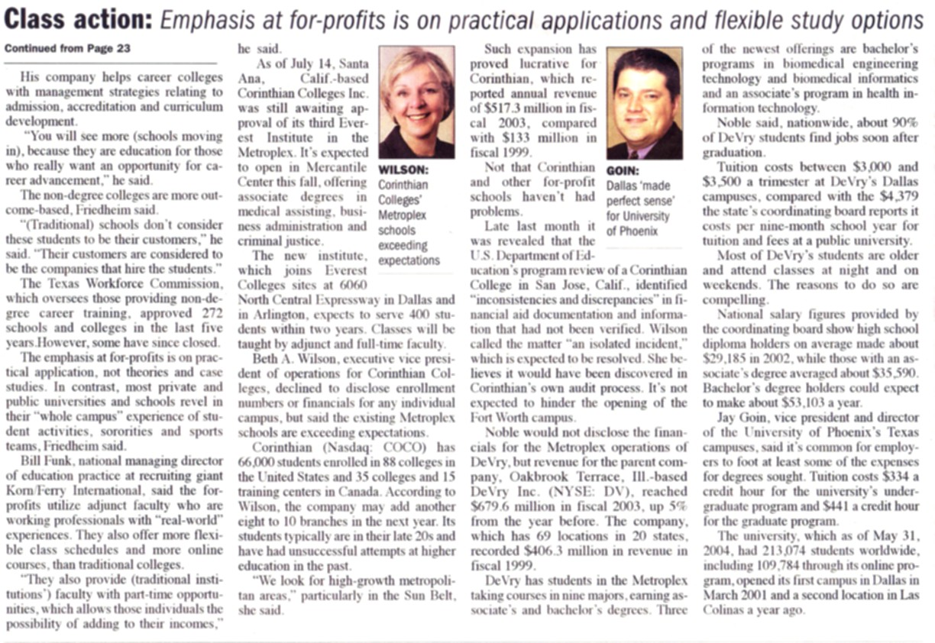
News and Trends

Slide 5
News and Trends

Slide 6
Biomed Program Launch

Slide 7
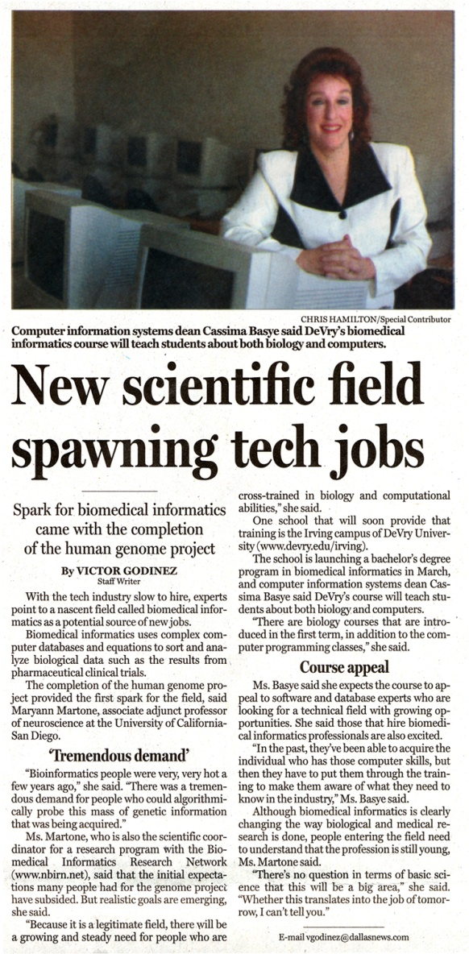
Biomed Program Launch

Slide 8
Game And Simulation Launch

Slide 9
Game and Simulation Launch

Slide 10
DeVry University Center Openings

Slide 11
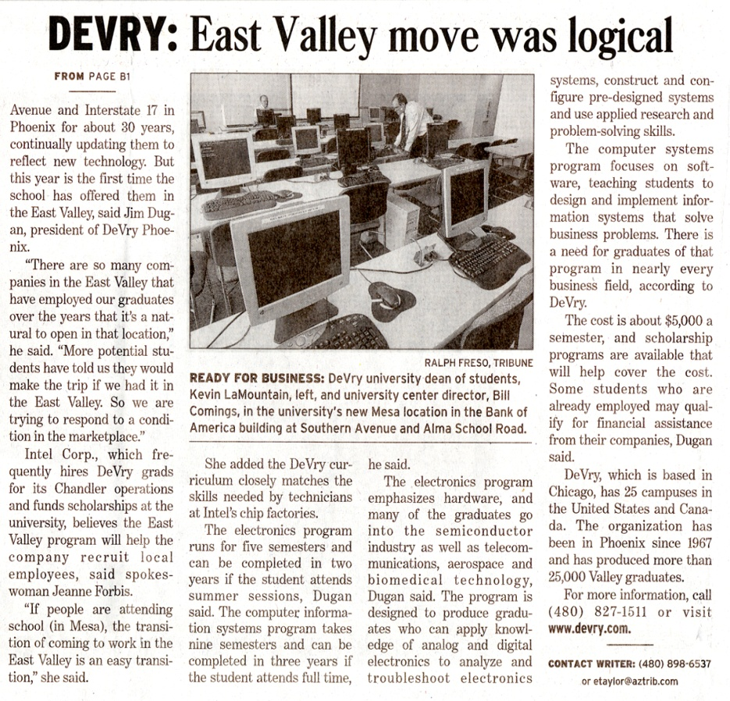
DeVry University Center Openings

Slide 12
Student Innovations

Slide 13
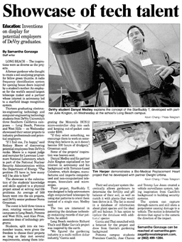
Student Innovations

Slide 14
Industry Experts

Slide 15
Industry Experts

